Slide 1
ECE 477 Midterm Design Review
IntelliFace
Team 1
Notes:
RSB

Slide 2
Outline
Project Overview
Major Components
Block Diagram
Packaging Design
Electrical Schematic
PCB Layout
Prototyping Progress
Software Development Status
Project Timeline
Questions and Discussion
Notes:
RSB

Slide 3
Project Overview
An intelligent interface with an intuitive user interface that:
wakes up after detecting the user’s gesture
authenticates the user
presents a dashboard containing a greeting and relevant information
latest emails, news, stock prices, weather, room temperature and an interesting quote.
Notes:
AS

Slide 4
PSSCs
An ability to successfully read ambient conditions using a temperature and light sensor using ADC and GPIO peripherals
An ability to perform user’s gesture detection using an infrared sensor on the STM32F0 using ADC
An ability to successfully communicate gesture readings, ambient light and temperature values between the STM32F0 and the Jetson Nano using USART
An ability to authenticate the user using a facial recognition API and the Jetson Nano
An ability to display metrics and relevant information (email, weather, stock tickers and news) using a dashboard on the Jetson Nano Monitor
Notes:
AS

Slide 5
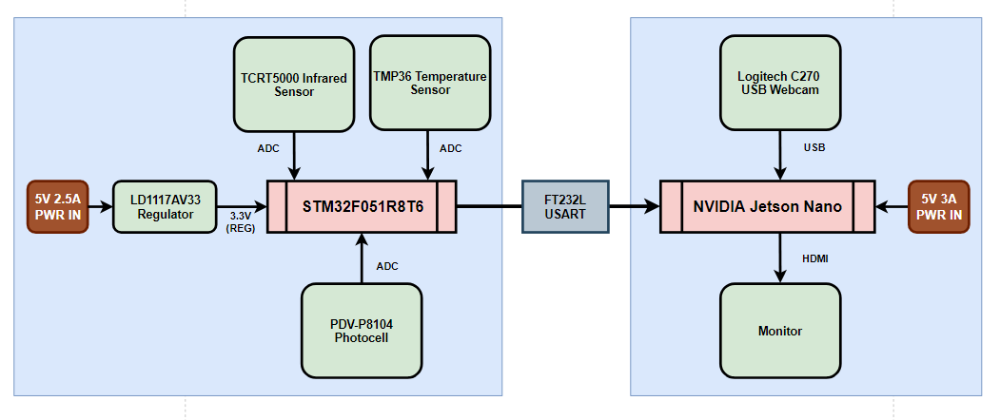
Block Diagram
Notes:
AS

Slide 6
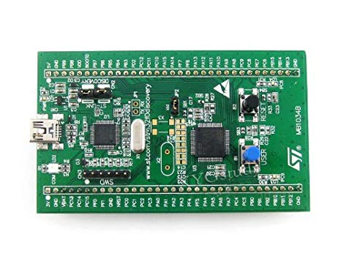
Component Selection: MCU
MCU | STM32F051R8T6 (chosen) | Freescale 9S12C32
Clock Speed | 48 MHz | 32 MHz
RAM | 8 KB | 4 KB
Operating Voltage | 2.0V to 3.6V | 2.97V to 5.5V
Timer | 8 | 8
UART | 2 | 0
Notes:
AS

Slide 7
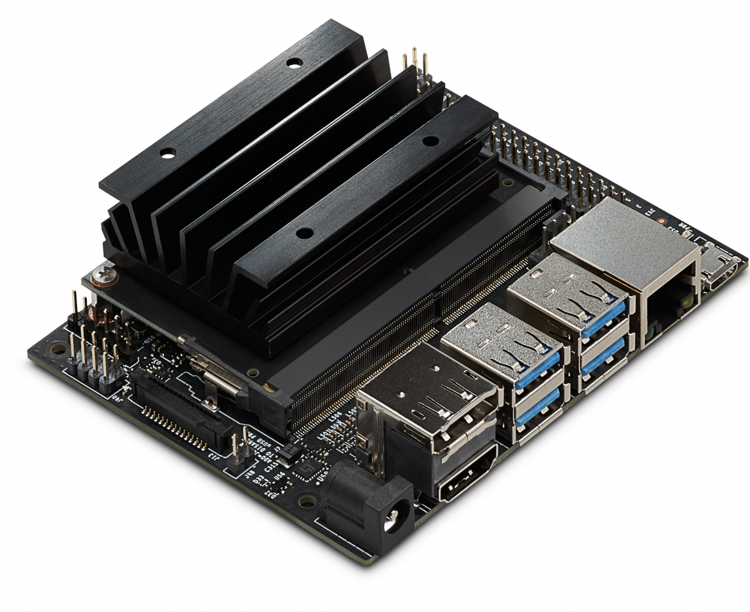
Component Selection: External Microcomputer
Microcomputer | Jetson Nano (chosen) | Raspberry Pi 4B
RAM | 4 GB | 1-4 GB
CPU | Quad-core ARM A57 @ 1.43 GHz | Quad core Cortex-A72 (ARM v8) @ 1.5 GHz
GPU | 128-core Maxwell | None
Shipping Time | ~ 2 days | ~ 2 weeks at Week 1
Cost | $98 | $70
Notes:
PS

Slide 8
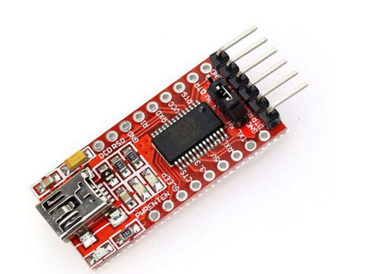
Component Selection: USART
FT232R:
Baud Rate: 115200
8-bit
Transmits data from the MCU to the Jetson in a Comma Separated format
Notes:
PS

Slide 9
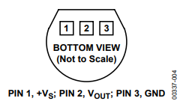
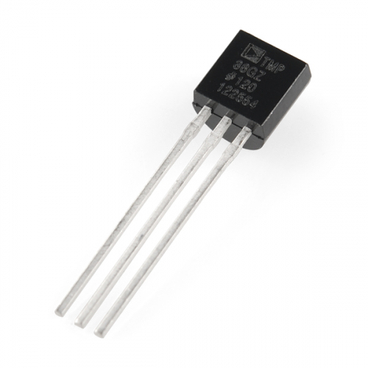
Component Selection: Temperature Sensor
Sensor | TMP36 (chosen) | LM61
Operating Voltage | 2.7 - 5 V | 2.7 - 10 V
Output Temperature Range | -40°C to 125°C | -30°C to 100°C
Operating Current | 50 µA | 125 µA
Price/piece | $0.70 | $0.79
Notes:
IA

Slide 10
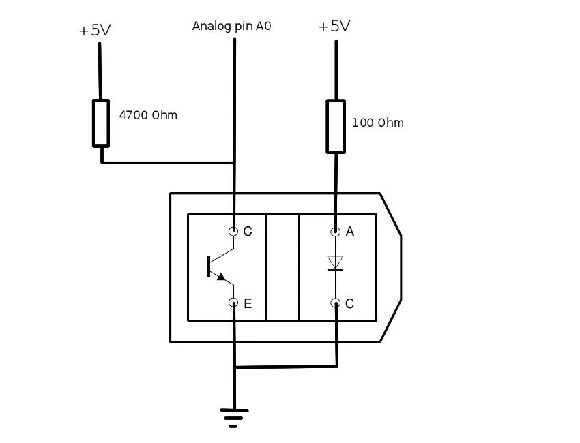
Component Selection: IR Sensor
Sensor | TCRT5000 (chosen) | GP2Y0A21YK
Operating Voltage | 2.7 - 5 V | 2.7 - 5 V
Maximum Detection Range | 10 cm @ 5V | 100 cm @ 5V
Operating Current | 40 mA | 50 mA
Price/piece | $0.40 | $13.89
Notes:
IA

Slide 11
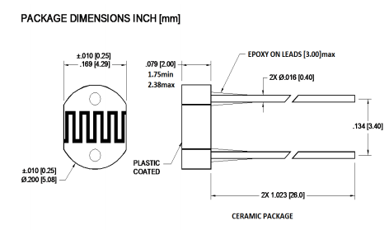
Component Selection: Light Sensor
Sensor | PDV-P8104 (chosen) | TEMT6000
Function | Photocell | Ambient Light Sensor
Operating Voltage | Up to 150V | 1.5 - 6V
Operating Current | 15 mA | 20 mA
Price/piece | $0.8 | $4.25
Notes:
IA

Slide 12
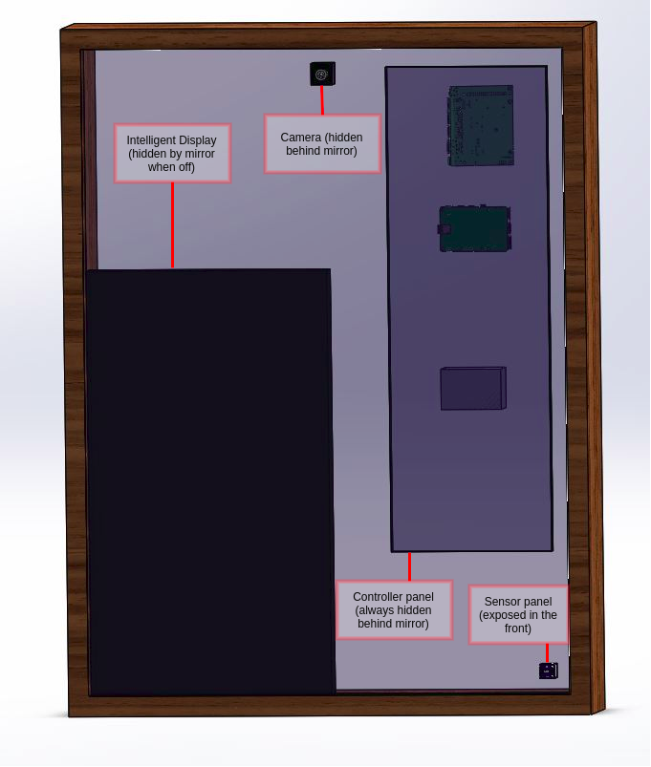
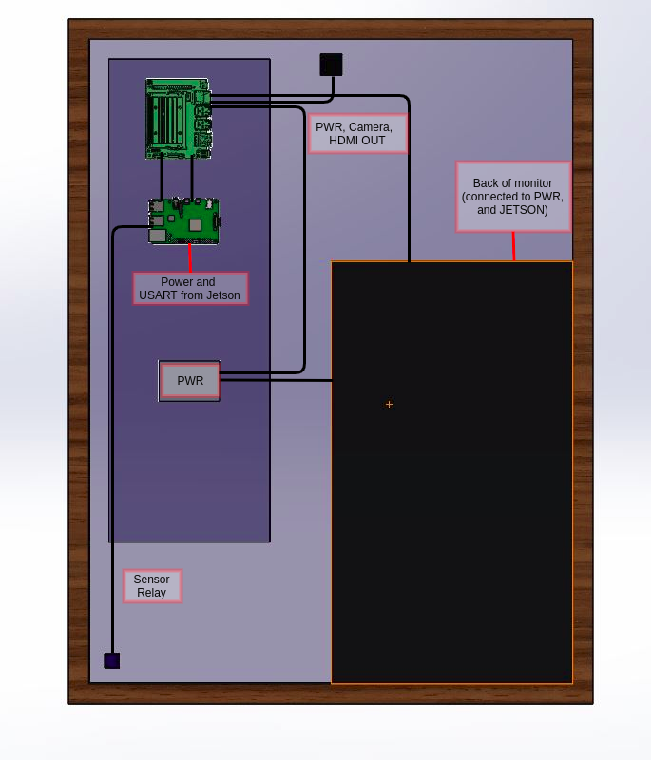
Packaging Design: Front (Left) and Rear (Right)
Notes:
RSB

Slide 13
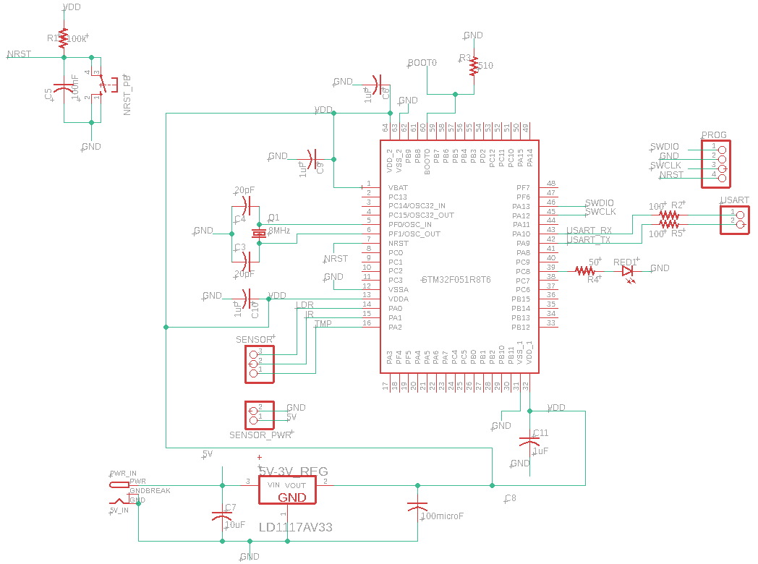
Schematic: Primary Board (MCU)
MCU:
Power Input from 5V Barrel Jack
Regulated using LD1117AV33 to 3.3V
Oscillator (OSC_IN_OUT 8MHz)
Connections:
TMP36 (ADC)
PDV-P8104 (ADC)
TCRT5000 (ADC, TIM15 + IRQ)
USART RX, TX
Notes:
RSB

Slide 14
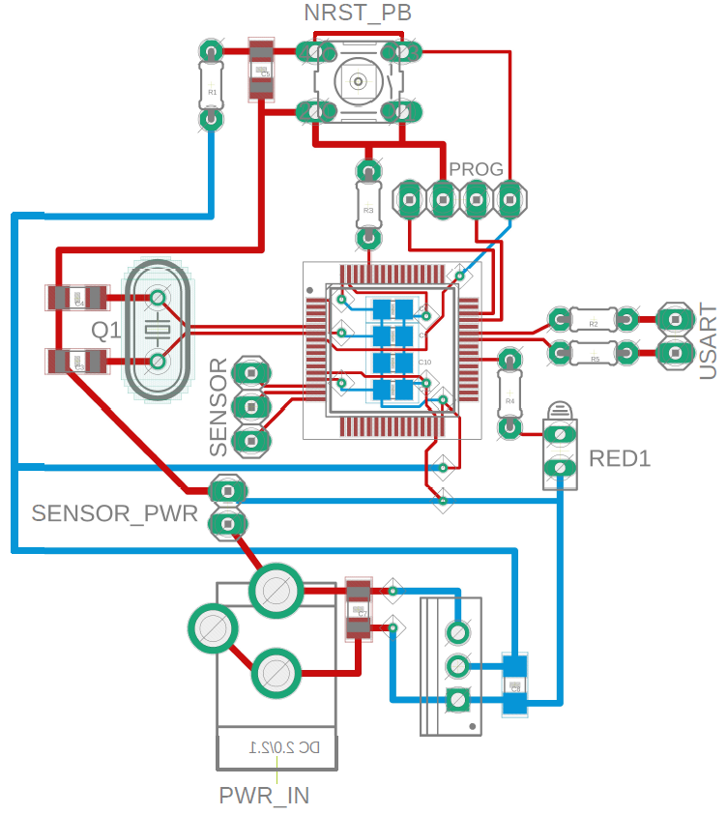
PCB Layout: Primary Board (MCU)
Notes:
RSB

Slide 15
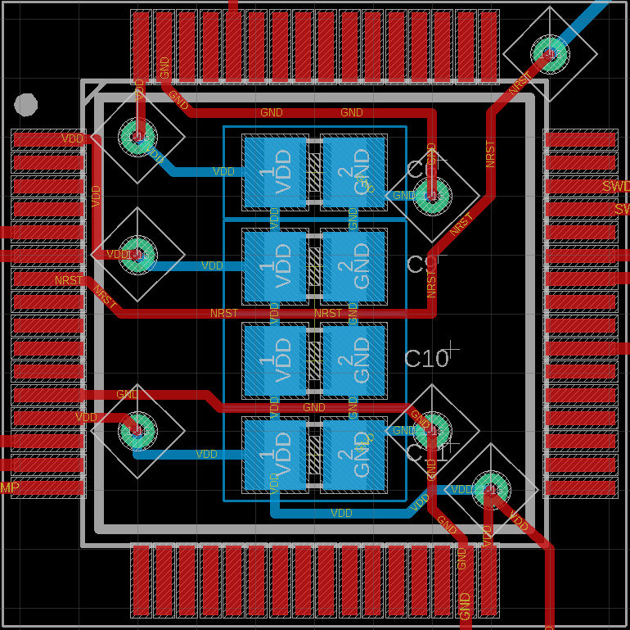
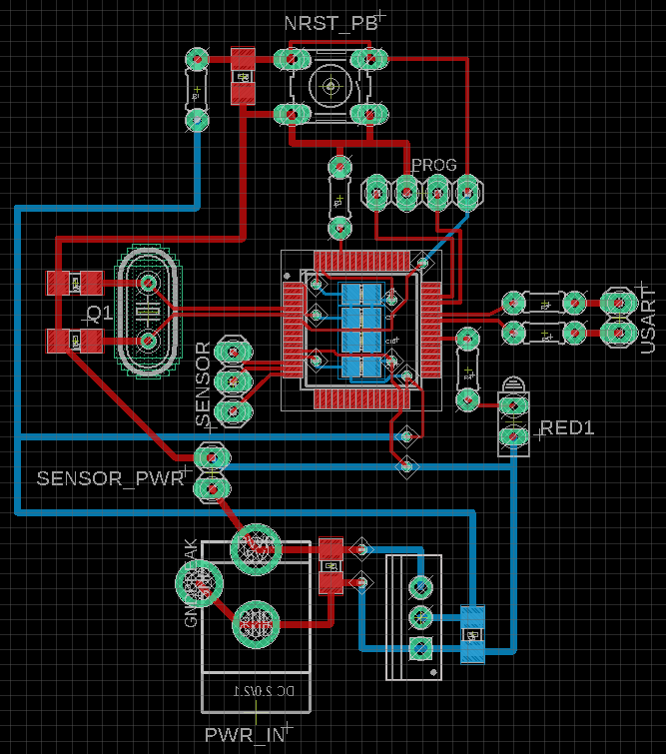
PCB Layout: Primary Board (MCU)
MCU and Decoupling
Capacitances
Notes:
RSB

Slide 16
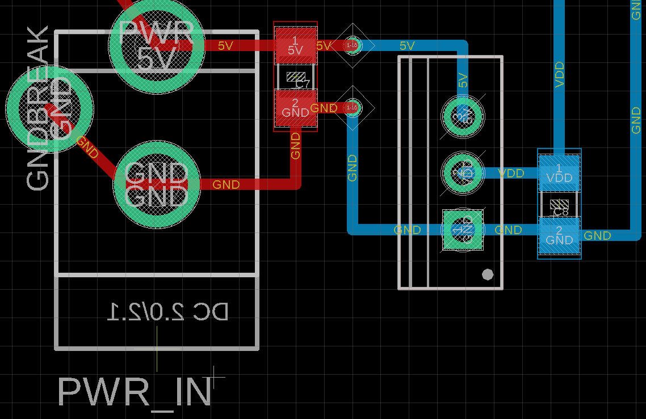
PCB Layout: Primary Board (MCU)
PWR IN and LD1117AV3 Regulator
Notes:
RSB

Slide 17
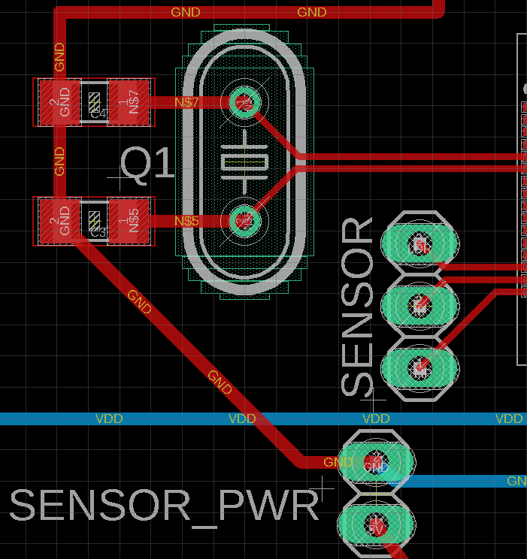
PCB Layout: Primary Board (MCU)
Oscillator and Headers to Sensor Board
Notes:
RSB

Slide 18
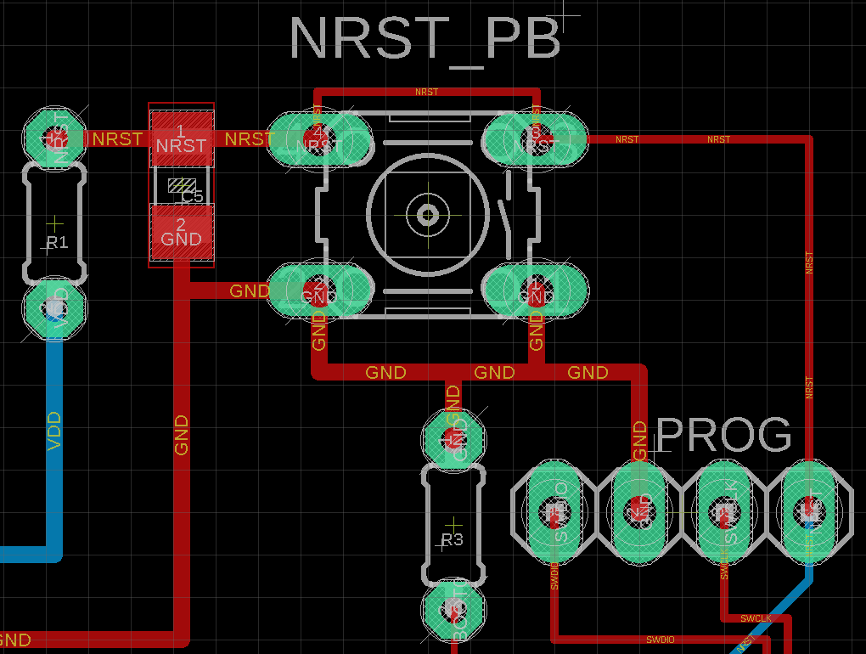
PCB Layout: Primary Board (MCU)
Reset Button and Programming Headers
Notes:
RSB

Slide 19
What needs adding: Primary Board
Low Pass filters for ADC sensors(?)
Mounting Holes (Orange)
Notes:
RSB

Slide 20
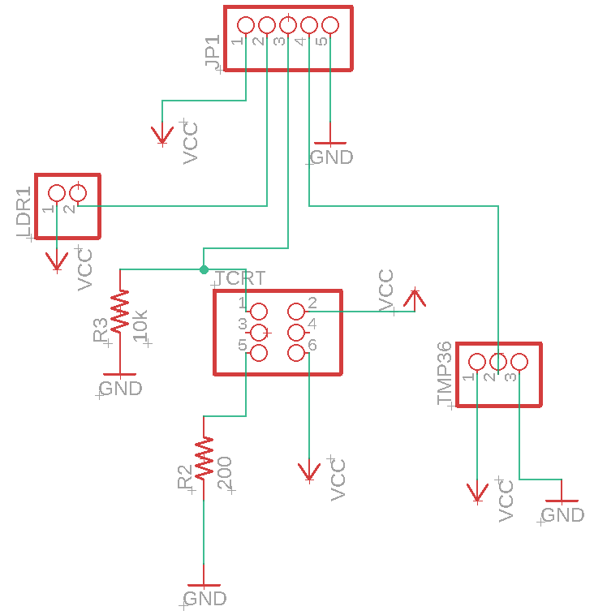
Schematic: Sensor Board
Notes:
IA

Slide 21
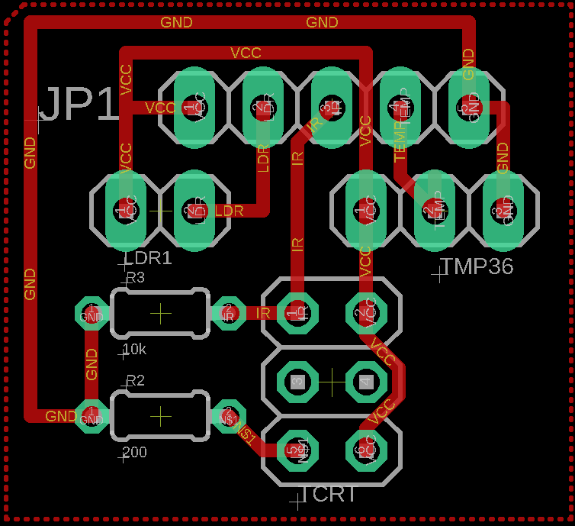
Layout: Sensor Board
Notes:
IA

Slide 22
Prototyping Progress
TMP36 | Getting sensor values, decoding them on STM32, and transferring them to NVIDIA Jetson through USART: DONE
TCRT5000 | Getting sensor values, decoding them on STM32, and transferring them to NVIDIA Jetson through USART: DONE
PDV-P8104 | Getting sensor values, decoding them on STM32, and transferring them to NVIDIA Jetson through USART: DONE
USART | One way serial connection from STM32 to Jetson Nano: DONE
NVIDIA Jetson Nano | Echoing received sensor values from STM32 to local terminal: DONE Displaying those sensor values on UI Dashboard: IN PROGRESS
Notes:
IA

Slide 23
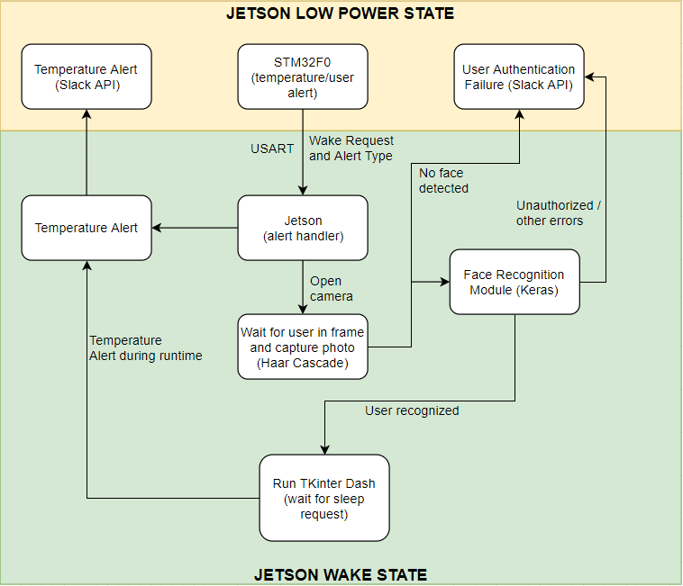
Software Overview
Notes:
RSB

Slide 24
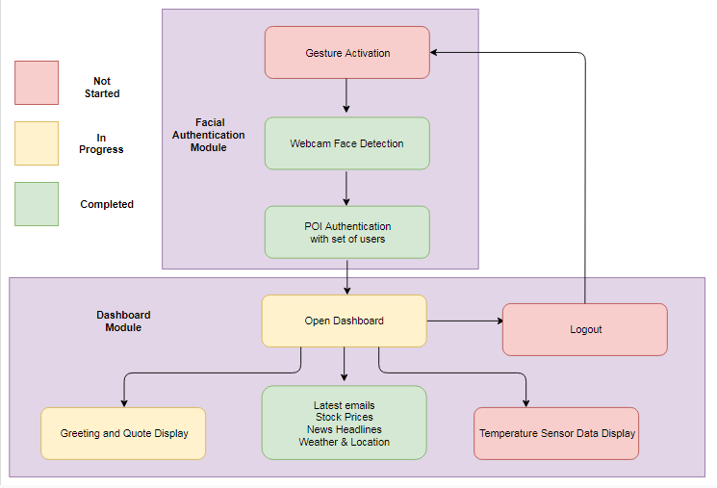
Software Development Status
Notes:
PS

Slide 25
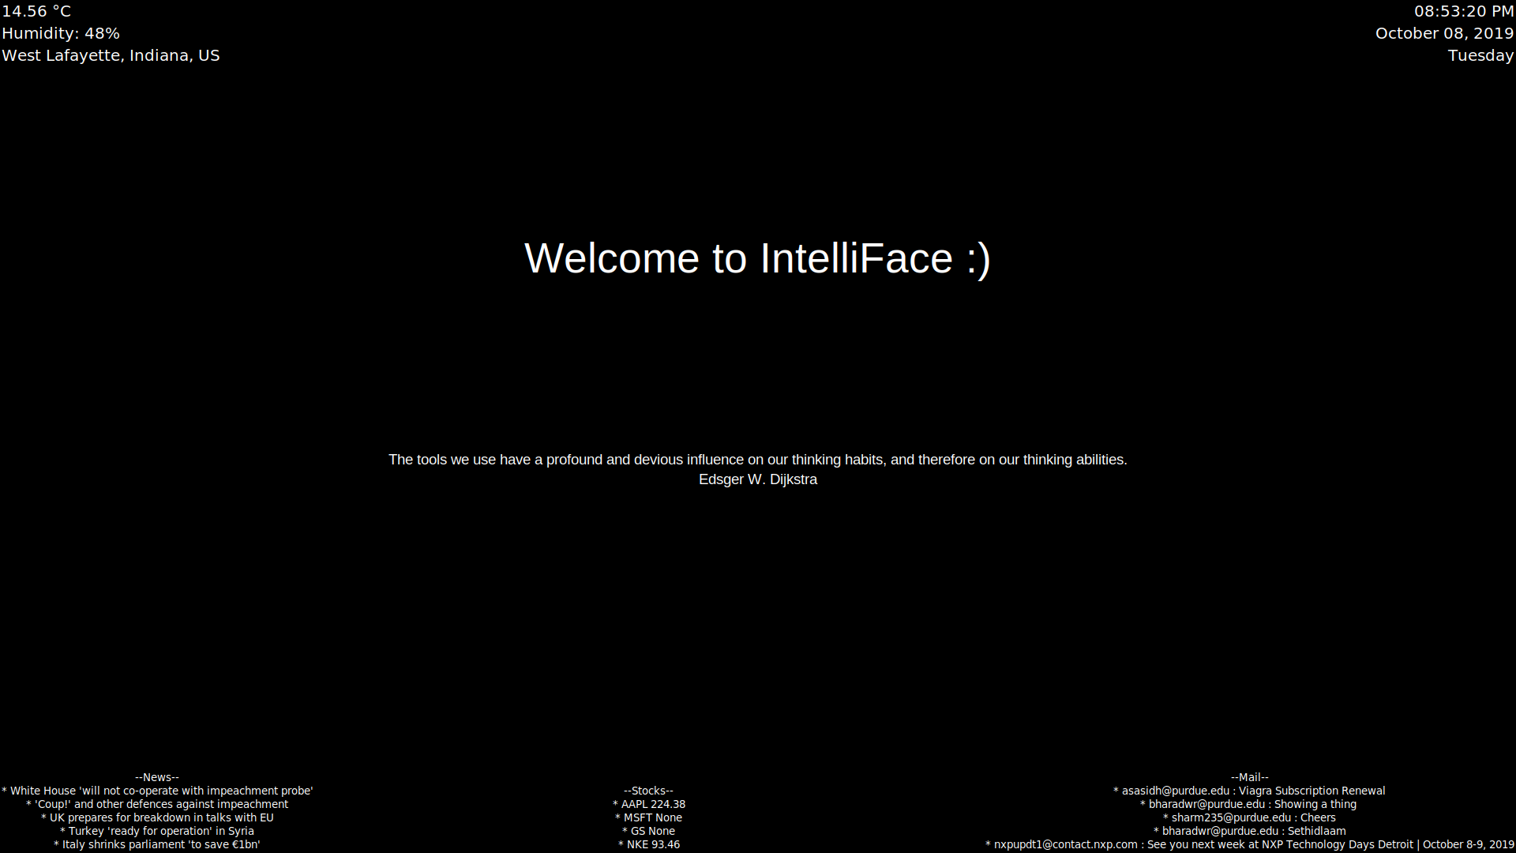
Software Development Status
Notes:
PS

Slide 26
System Processes
Background Processes (systemd):
Screen Brightness Adjuster: IN PROGRESS
Mail Aggregator: COMPLETED
USART Screener: IN PROGRESS
Foreground Processes:
Tkinter Dashboard: IN PROGRESS
Keras InceptionV3 R-CNN: PENDING VALIDATION
Notes:
PS

Slide 27
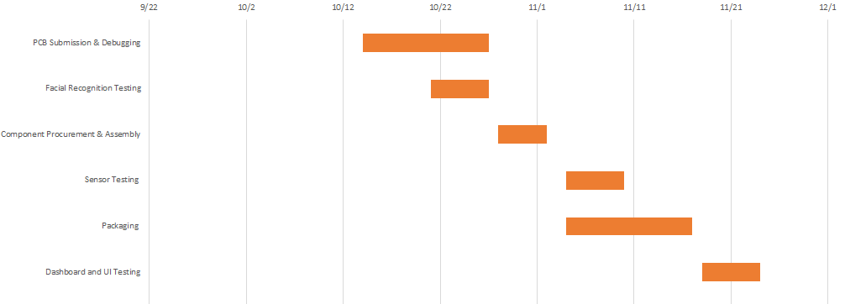
Project Timeline
Notes:
RSB

Slide 28
Questions?
Notes:
RSB

Slide 29
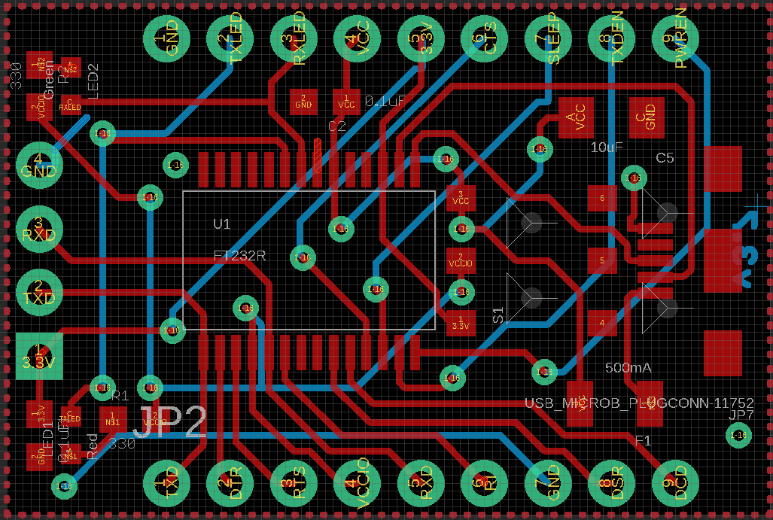
Board for FT232R USART
Sparkfun, “FT232RL USB Breakout,” Sparkfun USB to Serial Breakout, Creative Commons ShareAlike 4.0 International License. [Online]. Available: https://www.sparkfun.com/products/12731.
Notes:
AS

